Slide 1
Student Sustained Investigations
And Ideas on Documentation

Slide 2
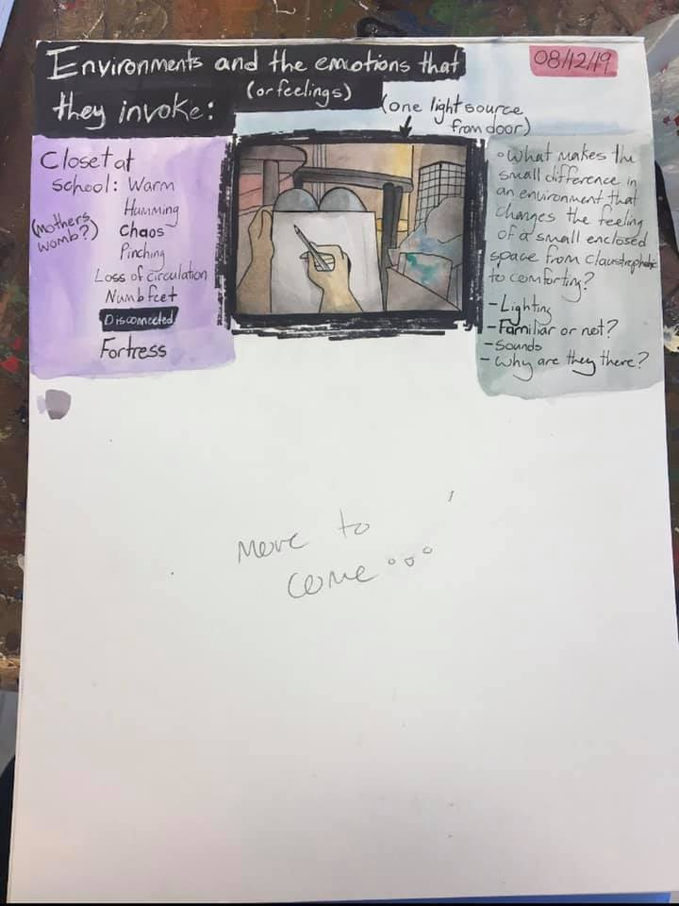
Student #1 investigating emotional response to environment- shown in a particular environment

Slide 3
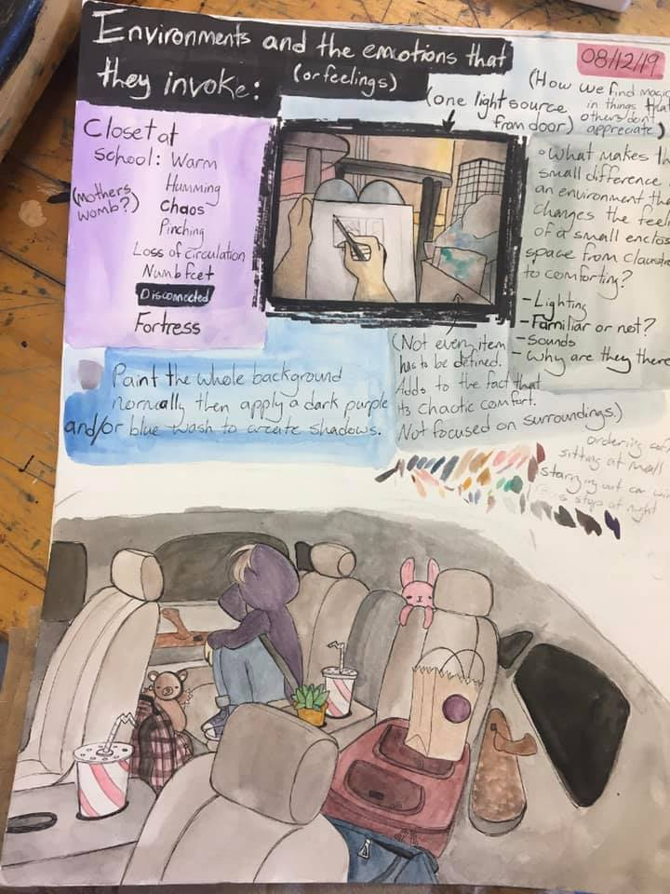

Slide 4
Student is exploring what colors she will use in the work. In blue there is a plan for the artwork and the bottom artwork shows the first stage in the plan. On the right, the artist lists ideas of future pieces

Slide 5
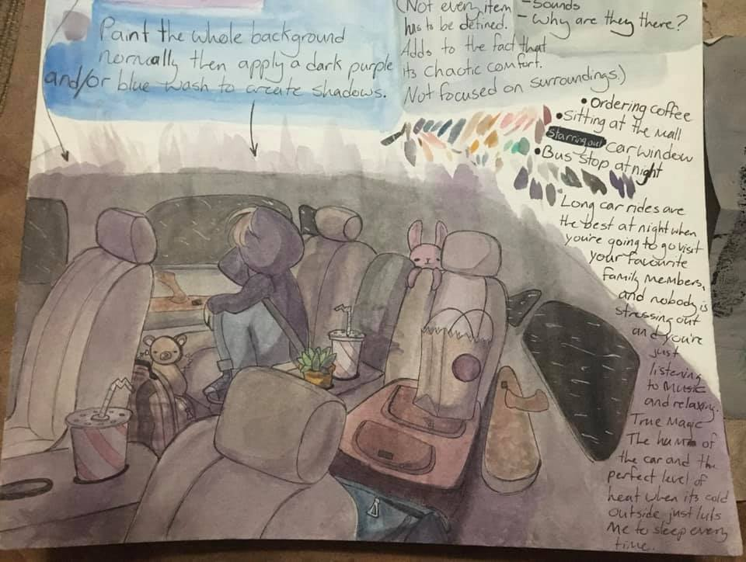
Work is showing 2nd stage in the process from the blue plan. Student elaborated on why this environment is explored

Slide 6
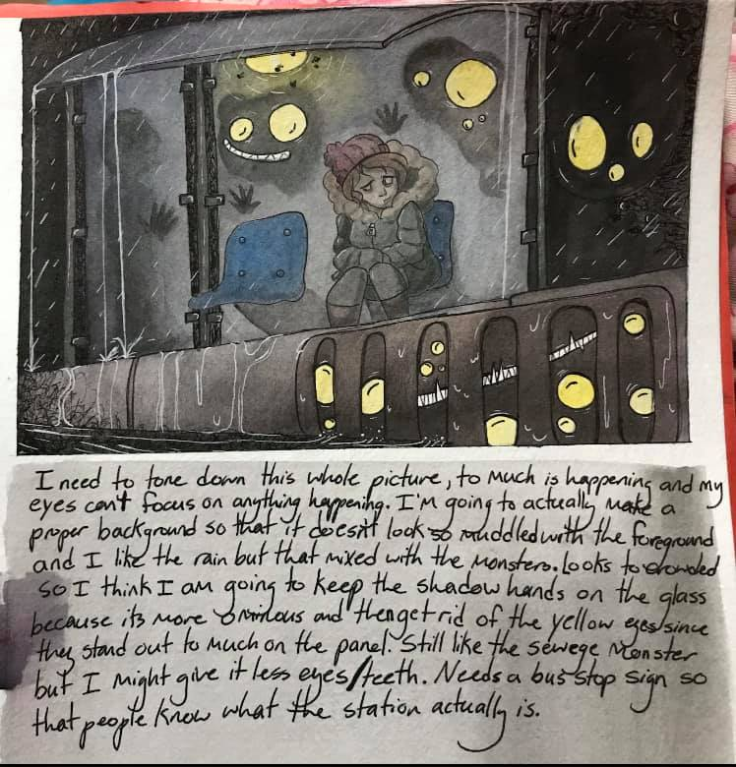
Student created a sketch of a final piece and then wrote about what worked/didn’t work. Usually, these comments come out during critique or conversation- write them down!

Slide 7
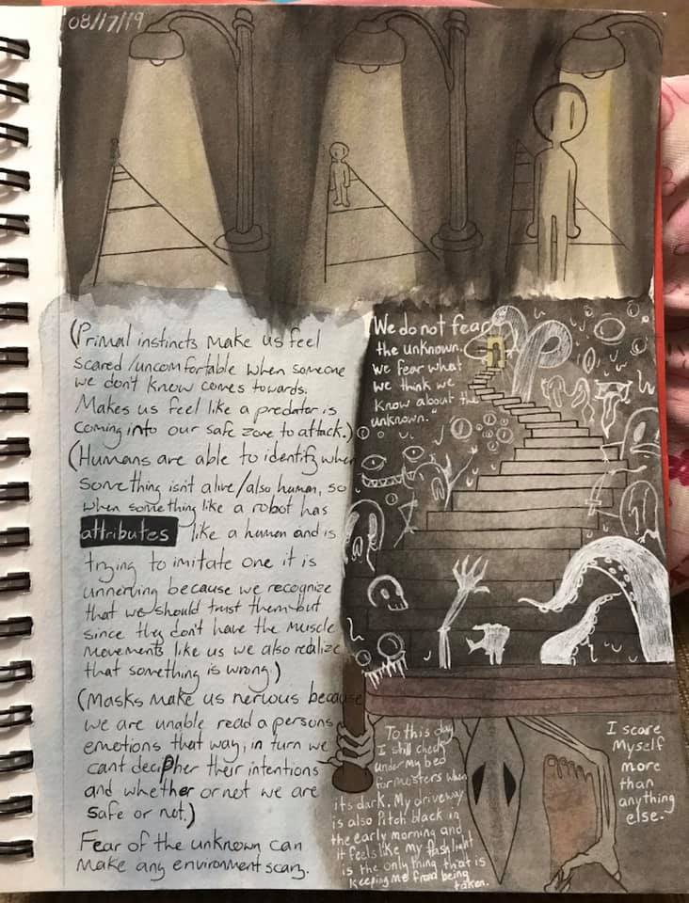

Slide 8
Student exploring the idea of fear/discomfort but not necessarily related to being in an environment, but showing the idea through the use of environment and characters

Slide 9
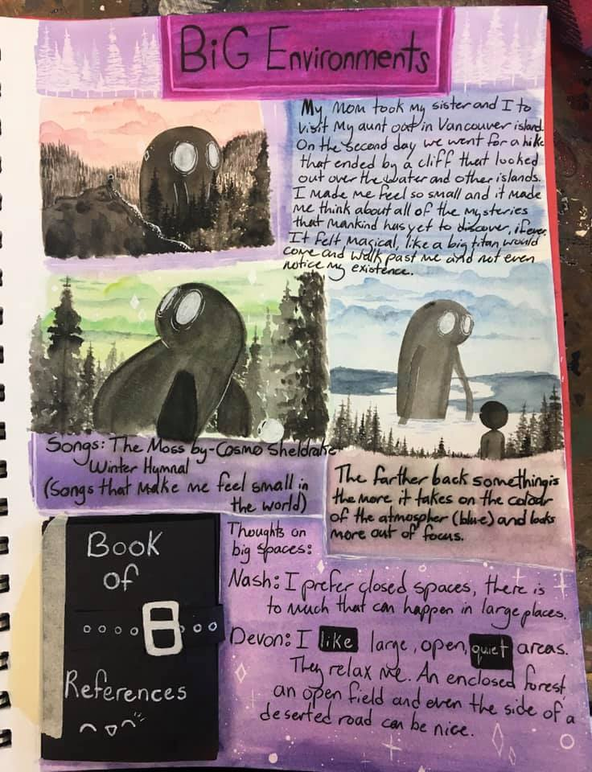

Slide 10
Student is exploring multiple ideas of large environments as well as how other people feel about large environments- as evidenced at the bottom. Student is showing inspiration for the work, exploration of the blue on the middle right, and experiments with layouts of the creature

Slide 11
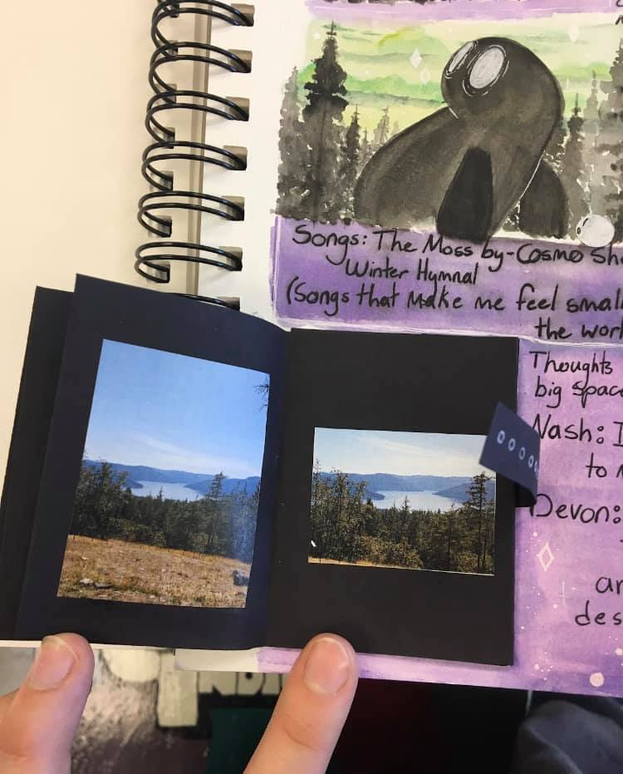
Student showing reference material>>>

Slide 12
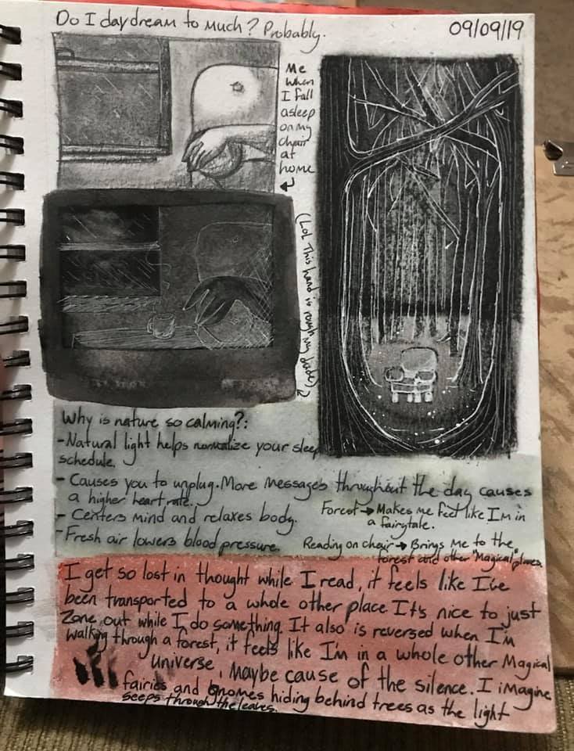

Slide 13
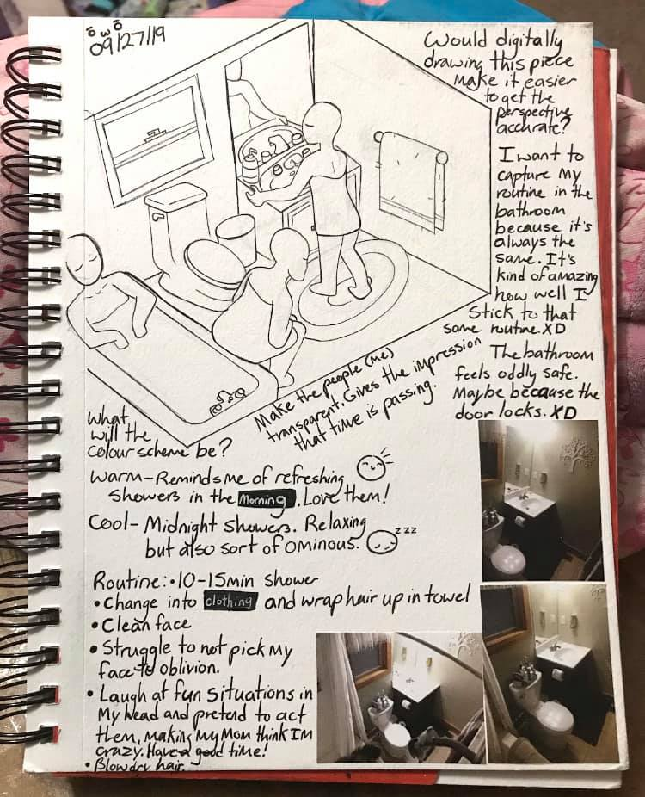

Slide 14
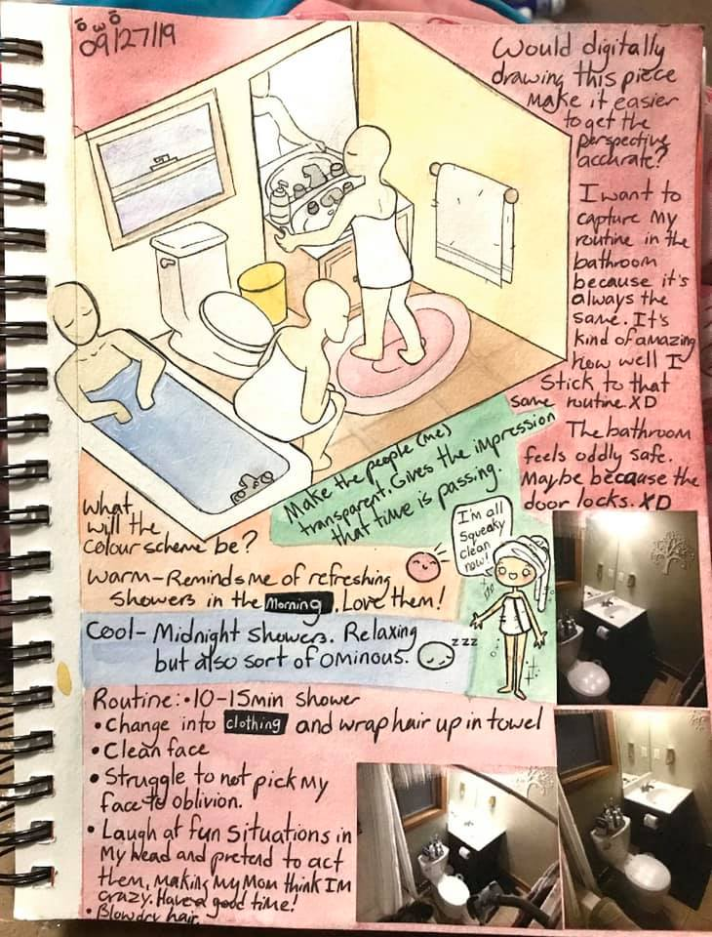

Slide 15
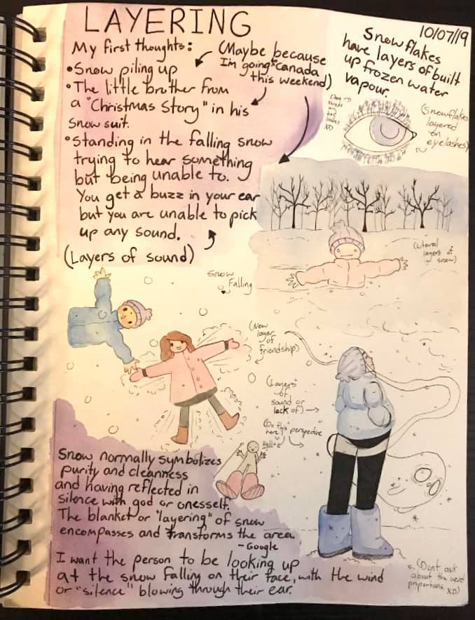
Student is writing literally anything that comes to mind related to the ideas- shows evolution of the idea from first pink ideas to last purple ideas.

Slide 16
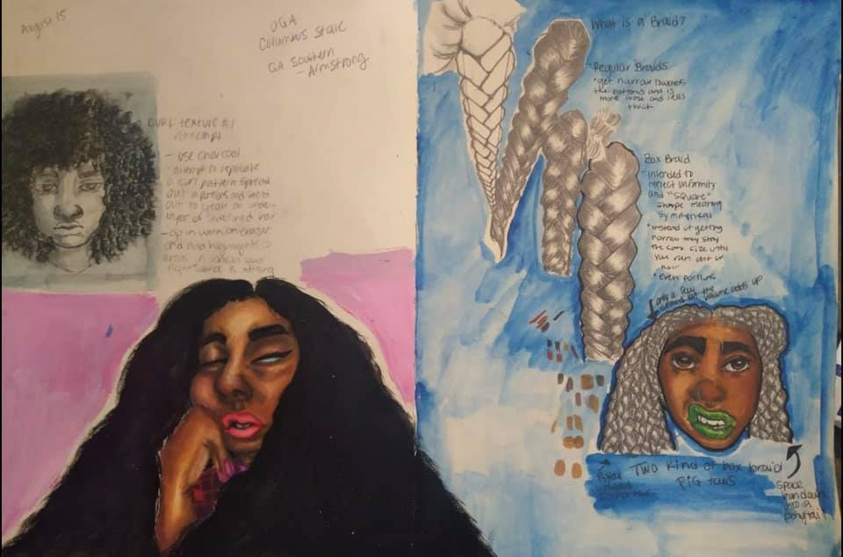
Student 2- Exploring cultural signify-cance of hair

Slide 17
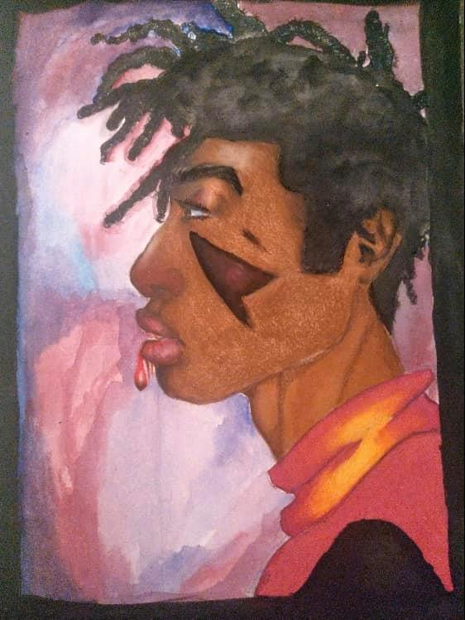

Slide 18
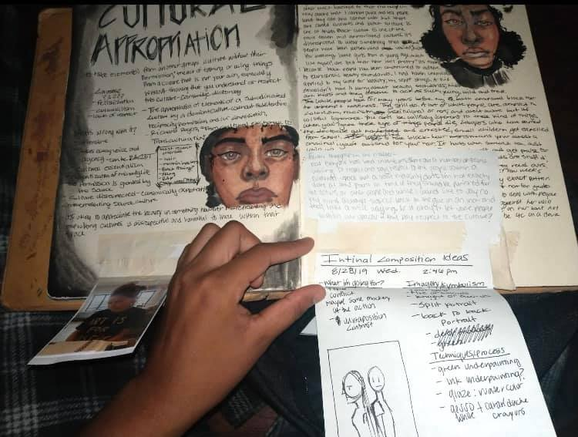
Extra thoughts and ideas put into sketchbook from other places- adds to documentation

Slide 19
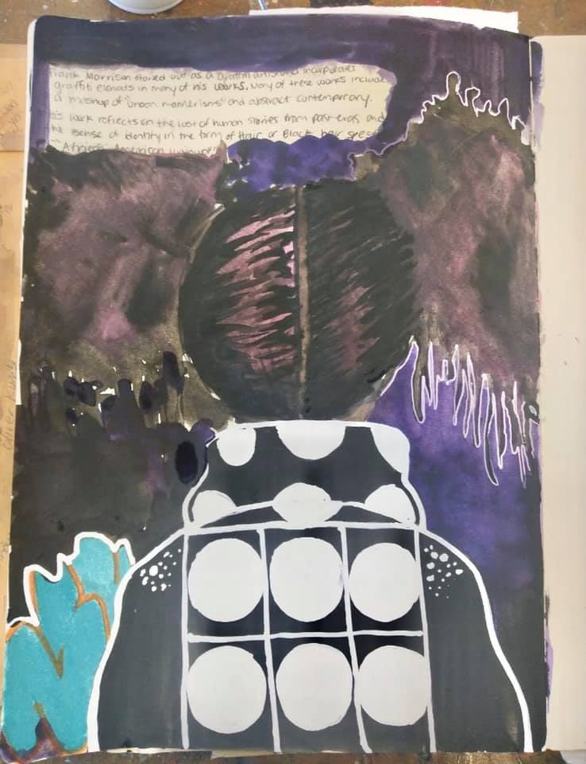
Student exploring white

Slide 20
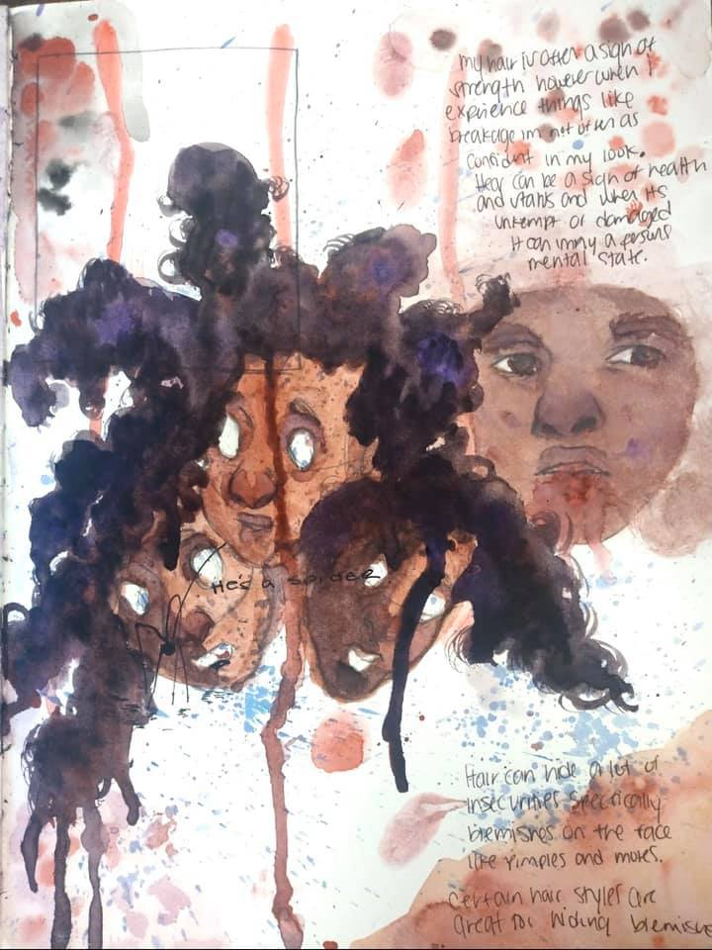

Slide 21
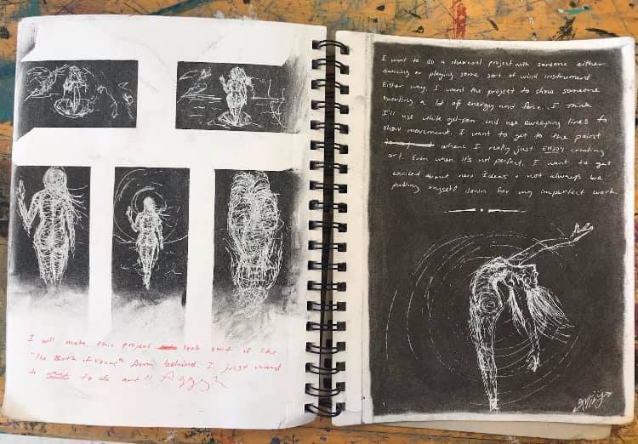
Student 3- loose investigation of the human form- Student exploring layering with black underneath and white on top- use of materials etc

Slide 22
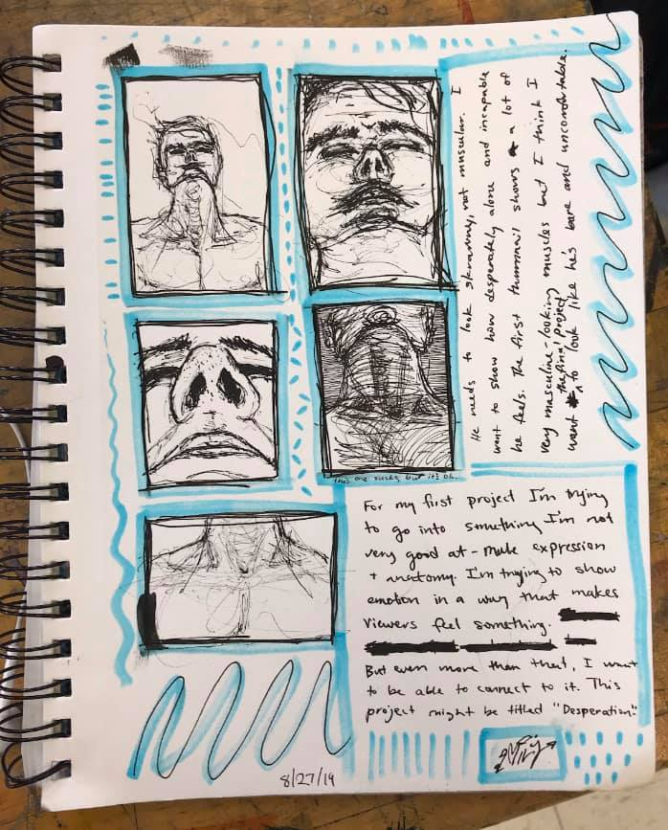

Slide 23
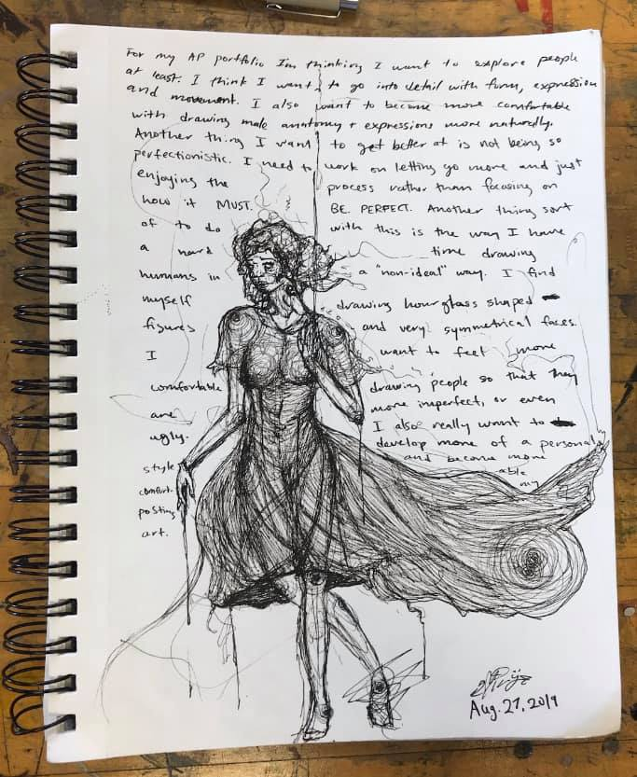

Slide 24
Final Thoughts
Many of these sketches were first thoughts by the student and the sustained investigation may have largely changed or altered their investigation since then.
Students may not have *perfectly* documented their experimentation, practice, and revision, but the ideas shown are a great start!
You must document EVERYTHING including thoughts that you have and how those thoughts change. You can do this through writing and imagery. You will be required to write a short blurb about each piece- your writing you do before hand can help drive that explanation.

