Slide 1
AP Art and Design
A Question is an Information Seeking Act- Kani Watson

Slide 2
The AP Requirements are changing

Slide 3
Sustained Investigation- A meandering path of inquiry
Must be related to an essential question- should be derived from a desire to explore a certain idea
15 images of works of art or documentation/process sketches exploring the investigation of an idea- each work should inform and inspire the next
Work submitted could be sketchbook pages or other documentation of sustained investigation. There is no required amount of completed art pieces.
Works are digitally submitted

Slide 4
Selected Works
Drawing and 2D Art and Design- 5 Physical works or high quality photos- Your absolute best work
3D Art and Design- 10 photos- 2 each of 5 pieces
These pieces are physically mailed to the AP College Board at the time of the exam and returned to you in July
Must demonstrate synthesis of materials, processes, ad ideas using skills required from the chosen portfolio
Must show impressive skill, technique, process, use of materials, etc.
Work can come from the Sustained Investigation or can be entirely different work

Slide 5
Types of AP Art and Design Portfolios
2-D Art and Design
3-D Art and Design
Drawing

Slide 6
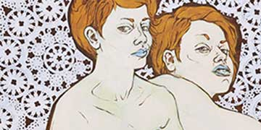
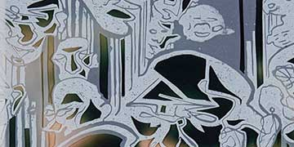
AP 2-D Art and Design
Designated for work that focuses on the use of 2-D elements and principals of art and design including point, line, shape, plane, layer, form, space, texture, color, value, opacity, transparency, time, unity variety, rhythm, movement, proportion, scale, balance, emphasis, contrast, repetition, figure/ground relationship, connection, juxtaposition, and hierarchy.
Students should consider how materials, processes, and ideas can be used to make work that exists on a FLAT SURFACE
Artwork can be made with any art media, processes, and ideas. Still images from videos or film are accepted. Composite images may be submitted.

Slide 7
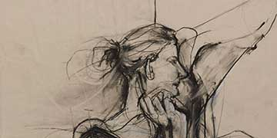
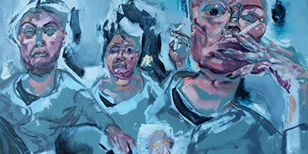
AP Drawing
This portfolio is designated for work that focuses on the use of mark-making, line, surface, space, light, and shade, and composition.
Students should consider marks that can be used to make drawings, the arrangement of marks, and relationships of marks and ideas.
Artwork can be made with any art media, processes, and ideas. Still images from videos or film are accepted. Composite images may be submitted.

Slide 8
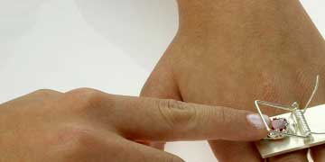
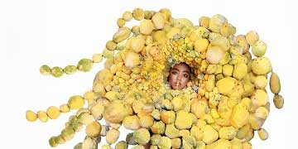
AP 3-D and Design
This portfolio is designated for work that focuses on the use of 3-Dimensional elements and principles of art and design, including point line, shape, plane, layer, form, volume, mass, occupied/unoccupied space, texture color, value, opacity, transparency, time unity, variety, rhythm, movement, proportion, scale, balance, emphasis, contrast, repetition, connection, juxtaposition, and hierarchy.
Students should consider how materials, processes, and ideas can be used to make work that involves space and form- work must activate/interact with space
Artwork can be made with any art media, processes, and ideas. Figurative or nonfigurative sculpture architectural models etc. Students may submit plans for 3D work as well. Still images from videos or film are accepted. Composite images may be submitted.
No Physical Work is submitted, only images

Slide 9
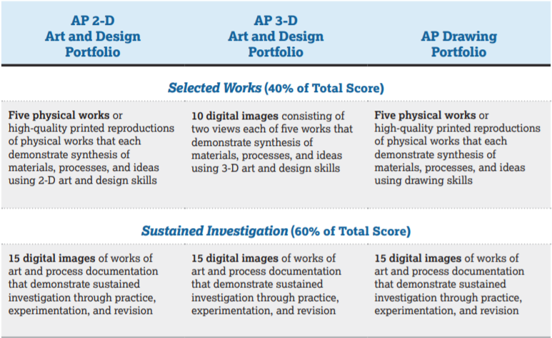
Portfolio Submission Requirements

Slide 10
Sustained Investigation Samples
Work from previous exam portfolios that show the new exam sustained investigation well

Slide 11
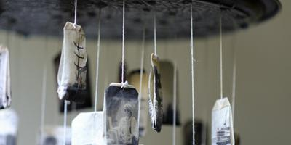
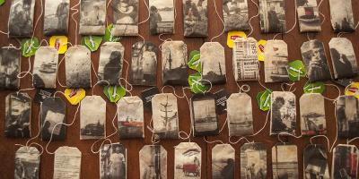
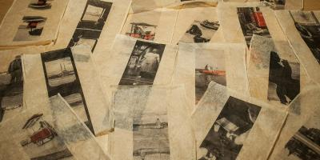
Tea Portfolio (2D Art & Design 2015) https://apcentral.collegeboard.org/series/ap-studio-art-2-d-design/portfolio/2015-student-samples/sustained-investigation-concentration

Slide 12
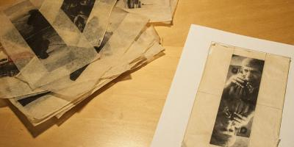
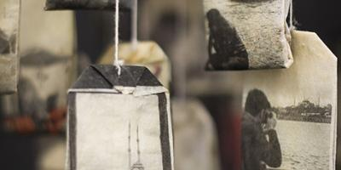
Thinking Backwards
What essential question did this student consider when creating this body of work?

Slide 13
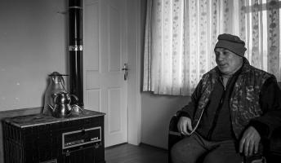
From College Board:
In this concentration, the student has created an unmistakably coherent series of works focusing on “tea as a metaphor for the power that bonds people with different cultures in the city of Istanbul.”
How could this description of the series be turned into a question?

Slide 14
What essential question did this student consider when creating this body of work?
2-D AP Art and Design Student Statement https://apcentral.collegeboard.org/courses/resources/2017-18-ap-studio-art-exhibit

Slide 15
2-D AP Art and Design Student Statement2-D AP Art and Design Student Statement https://apcentral.collegeboard.org/courses/resources/2017-18-ap-studio-art-exhibit

Slide 16
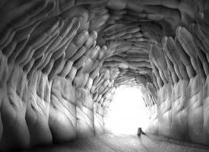
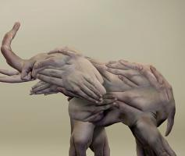
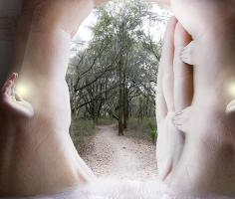
2D Portfolio 2016 https://apcentral.collegeboard.org/series/ap-studio-art-2-d-design/portfolio/2016-student-samples/sustained-investigation-concentration

Slide 17
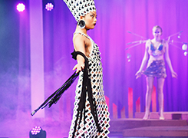
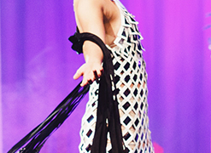
3-D Art and Design Portfolio (17-18) https://apcentral.collegeboard.org/courses/resources/2017-18-ap-studio-art-exhibit

Slide 18
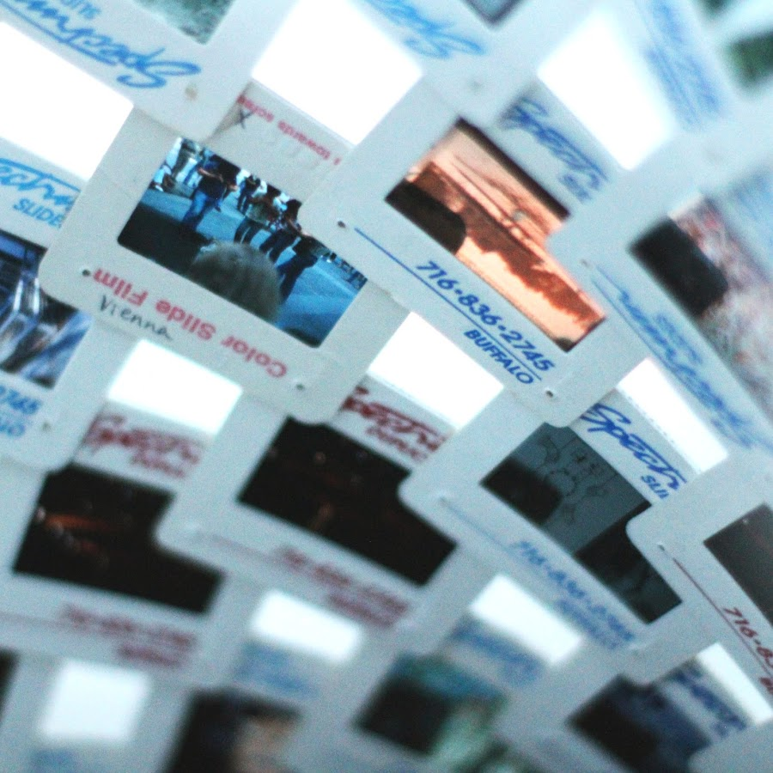
Detail shot makes material choice more obvious to evaluators.
https://www.youtube.com/watch?v=PMSvIyd_KXA

Slide 19
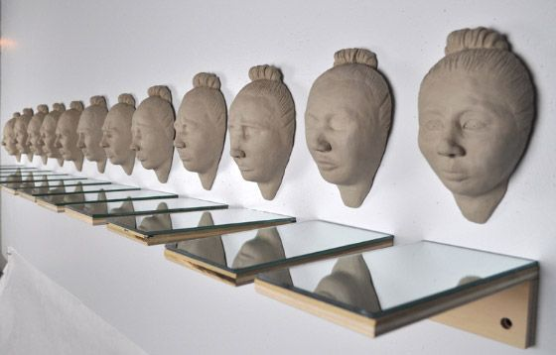
3D AP Art and Design Portfolio(17-18) https://apcentral.collegeboard.org/courses/resources/2017-18-ap-studio-art-exhibit

Slide 20
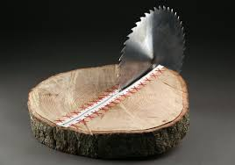
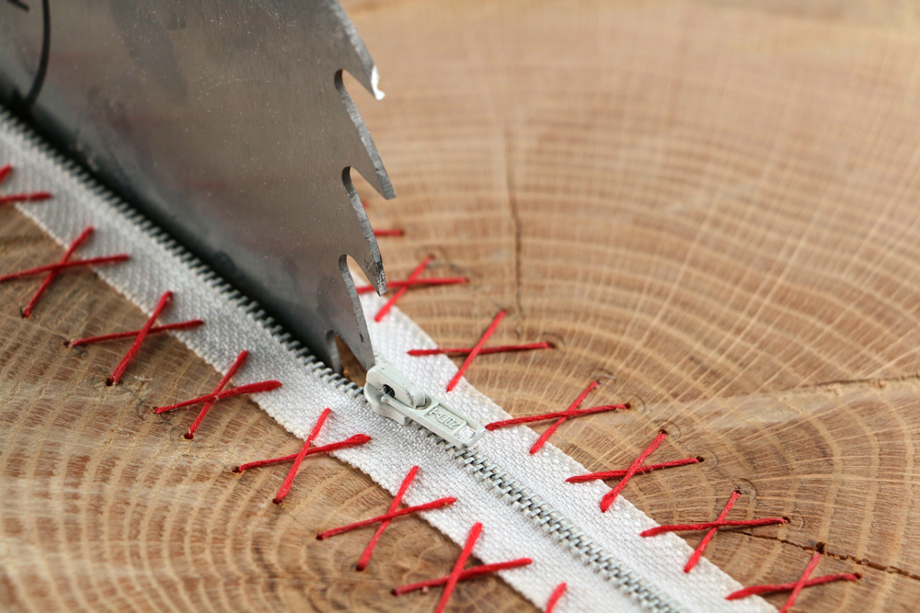
What do you think the essential question was behind this work?
AP 3D Portfolio

Slide 21
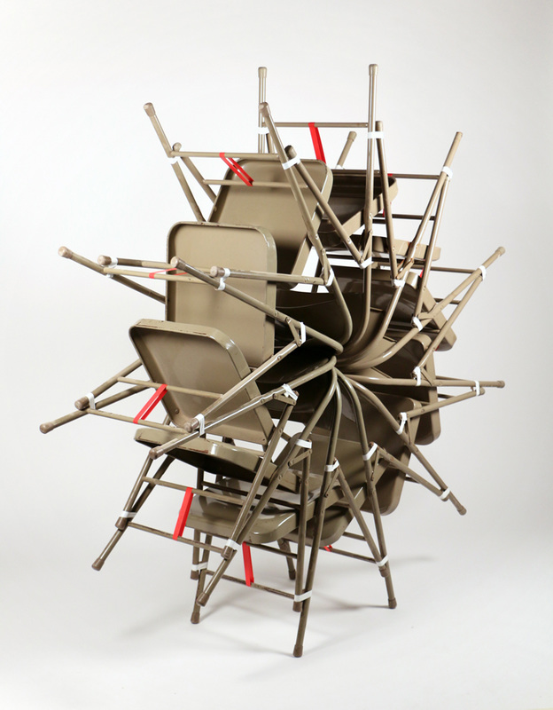
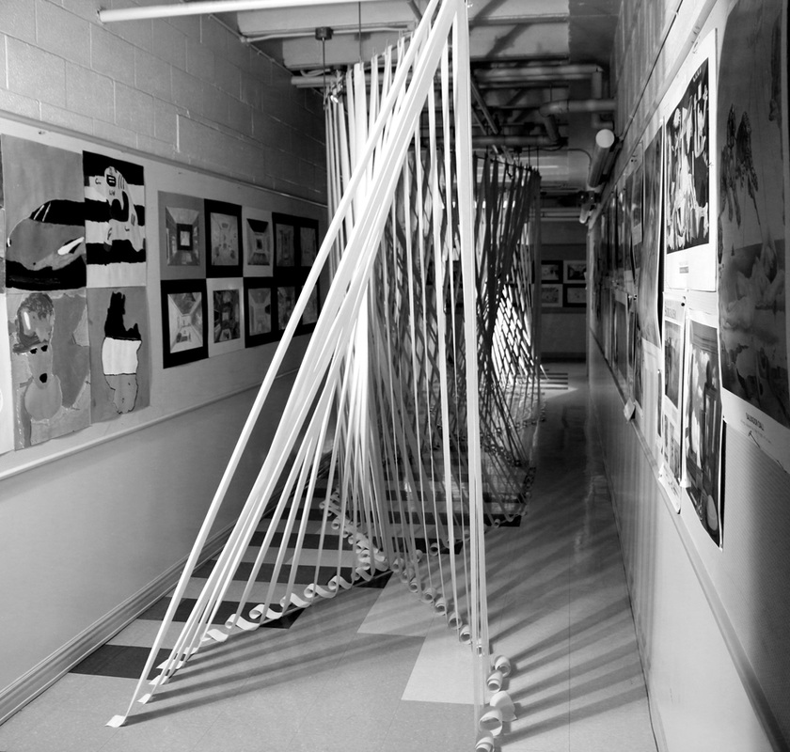
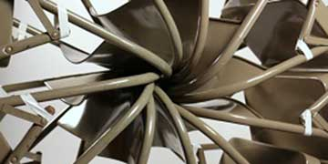
AP 3D Art and Design Portfolio https://apcentral.collegeboard.org/courses/resources/2016-17-ap-studio-art-exhibit http://michaelwebster.weebly.com/eric-price-score-5.html

Slide 22
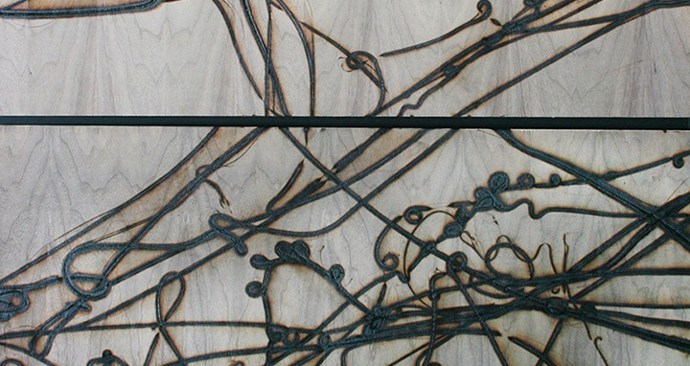
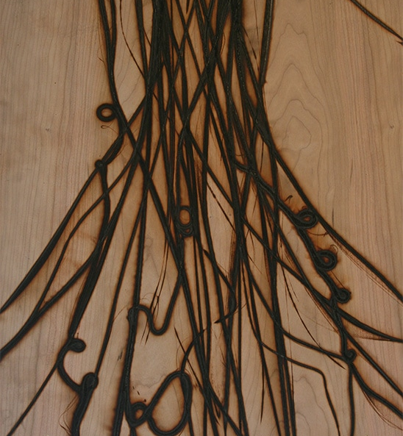
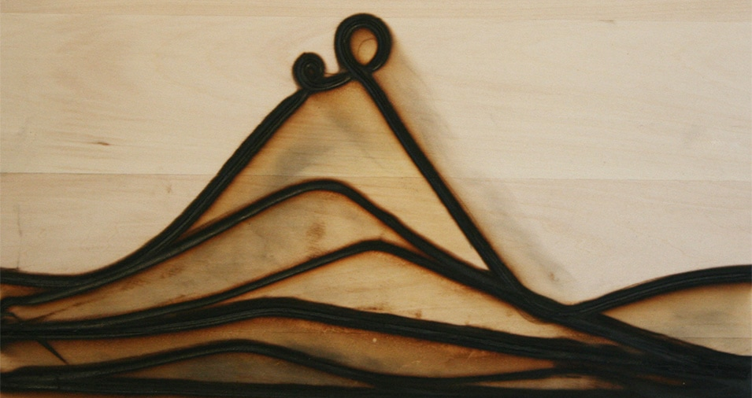
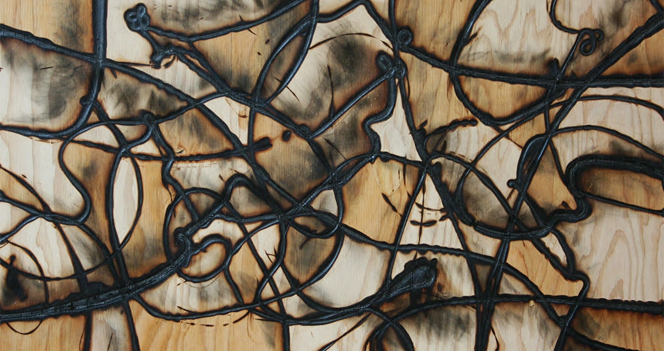
What which portfolio do you think this work was submitted?

Slide 23
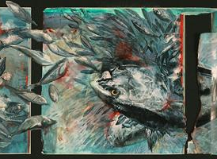
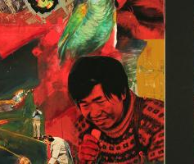
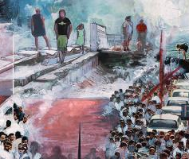
AP Drawing 2016 https://apcentral.collegeboard.org/series/ap-studio-art-drawing/portfolio/2016-student-samples/sustained-investigation-concentration

Slide 24
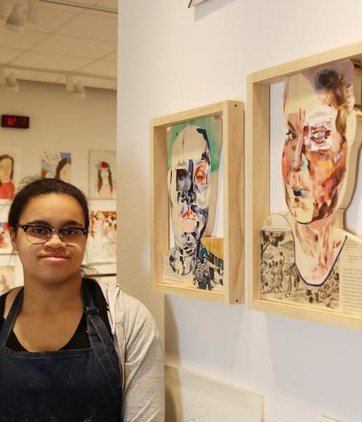
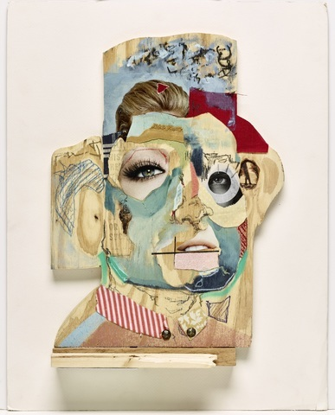
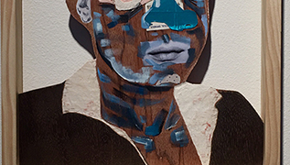
What portfolio do you think this work was submitted in?
Media: oil, spray paint, plastic baby arm, found paper, canvas, felt, house paint, graphite, and wood stain on carved wood
https://apcentral.collegeboard.org/courses/ap-studio-art-drawing/portfolio/2017-studio-art-drawing-complete-portfolio-sample
https://theredledger.net/2017/03/06/hannah-lawson/
https://apcentral.collegeboard.org/courses/resources/2017-18-ap-studio-art-exhibit

Slide 25
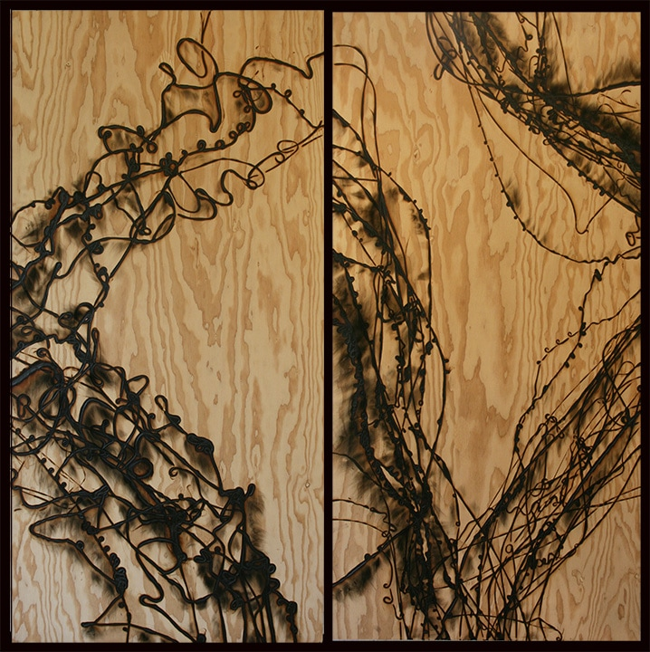
Work was made from pouring molten glass onto plywood. Portfolio was Drawing as this work focused on mark making. https://apcentral.collegeboard.org/courses/resources/2017-18-ap-studio-art-exhibit

Slide 26
What is a Sustained Investigation?
Take one minute to write, in your own words, a definition or summary of the Sustained Investigation section of the AP Art and Design portfolios.

Slide 27
What is the Selected Works Section?
How many pieces are required?
How are these images submitted?
Take two minutes to write, in your own words, your understanding of this section.

